Slide 1
FTC Autonomous Programming

Slide 2
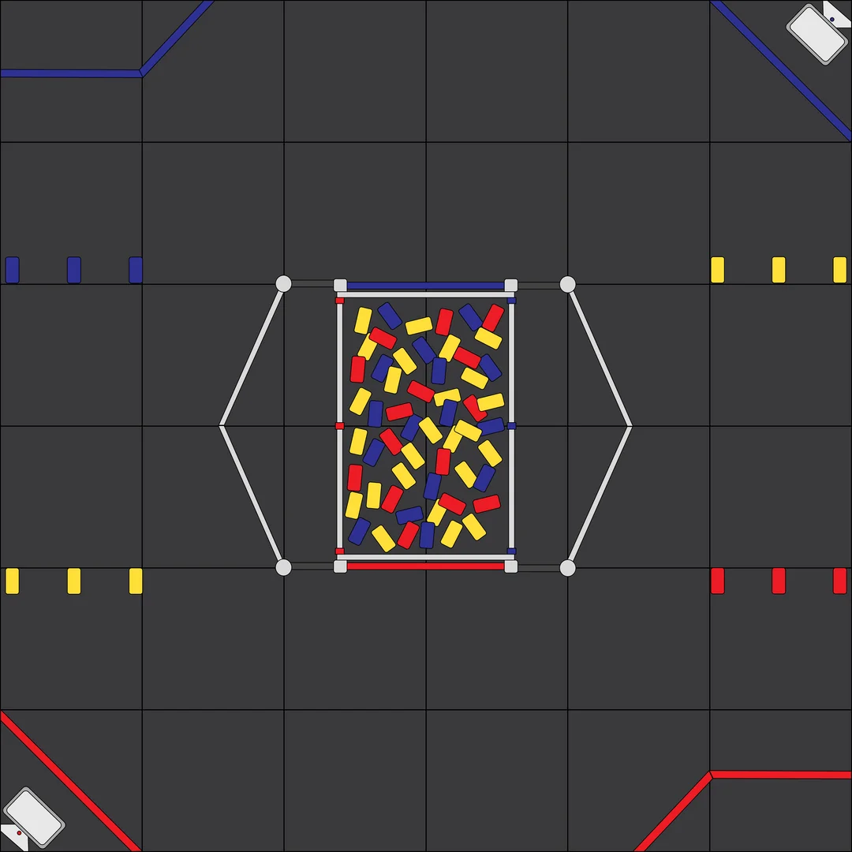
Libraries
Both 26145 and 24124 programmers use two libraries aside from the FTC SDK. Roadrunner, and Meep Meep.
Roadrunner: Program used to calculate the robot’s position using various sensors, follow trajectories, and give power to the motors in the 30 second autonomous period. This library allows for creative and reliable pathway development quickly.
Meep Meep: Program used to develop and simulate trajectories (path the robot takes throughout the field) (This is not necessary for the robot to function, however, it saves a great amount of time).

Slide 3
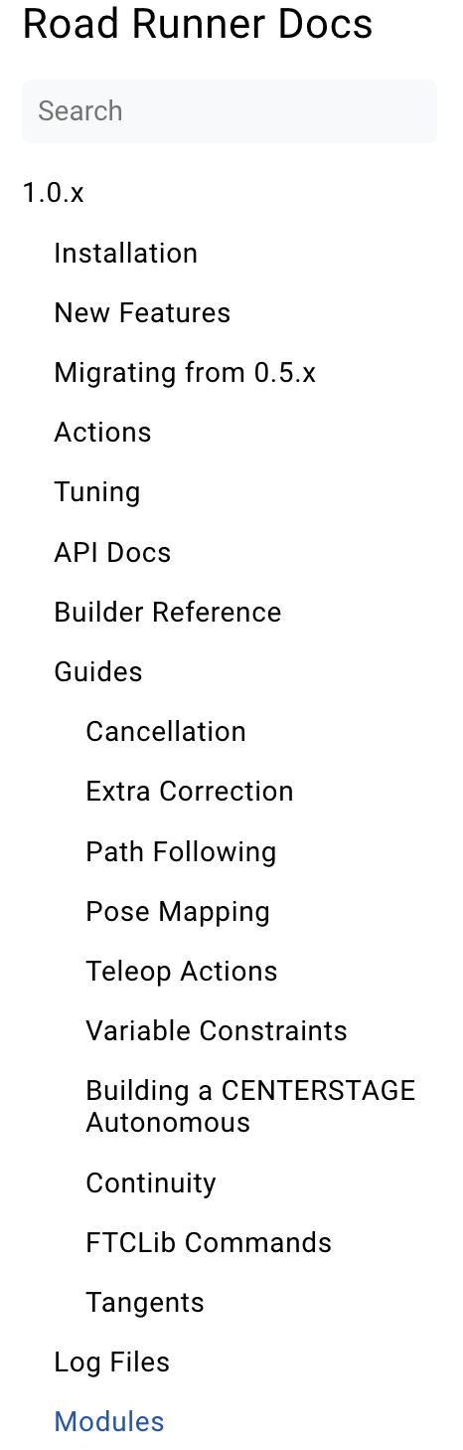
Roadrunner 1.0 Installation
https://rr.brott.dev/docs/v1-0/installation/ ← follow all these steps in this link.
Bookmarking the tab is recommended as you will be visiting it very frequently.
All Roadrunner related information in this slideshow is derived from this documentation so you can visit it at any time.
I recommend reading through all pages below 1.0.x and above 0.5.x on the left bar of contents.

Slide 4
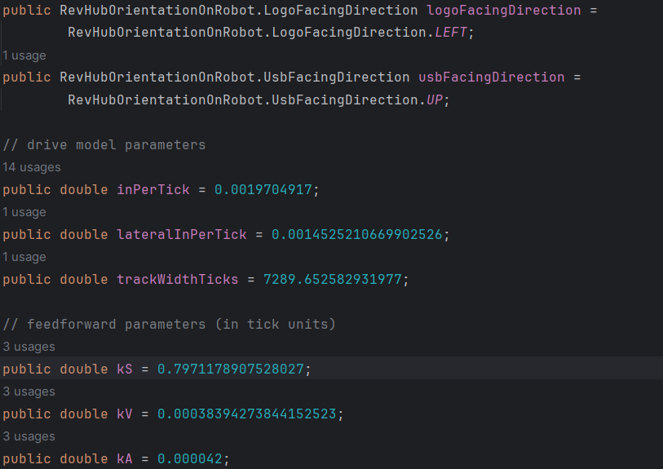
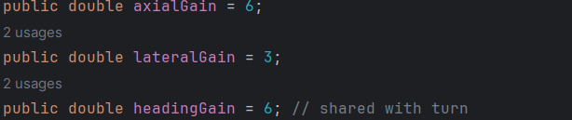
Roadrunner 1.0 Tuning
This step is time consuming and repetitive. For Roadrunner to function properly, it must be tuned to a specific robot’s weight, odometry positions, and errors. The Roadrunner docs has a page dedicated to tuning different types of robots: https://rr.brott.dev/docs/v1-0/tuning/
Tuning variables:

Slide 5
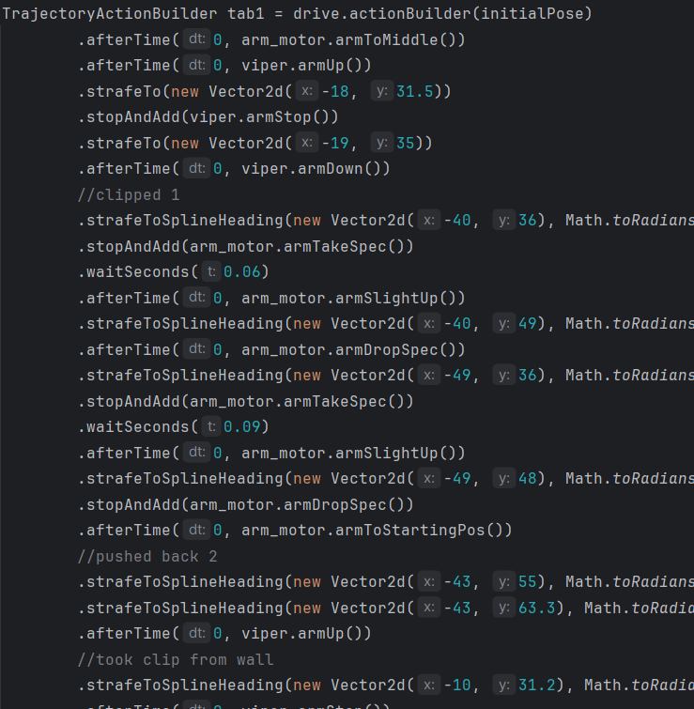
Roadrunner 1.0 Trajectories
Initializing and Building a trajectory:
Create a file and give it a name of your choice
Create variables
Create actions
Determining starting position
Initialize
Building trajectory
Placing the trajectory in a sequential action and calling the action’s command.
A sample code is given in the building a CENTERSTAGE autonomous part of the RR docs. Experiment with that code and see what works for you.

Slide 6
Roadrunner 1.0 Trajectory/Action Commands
Tangents: Controls which direction the robot will start to move in. Tangent angles are presented on the top left corner of the Meep Meep tab (More about this later in the slides). Experiment with tangents to get a strong understanding of them. Ending tangents are also present in some commands, which control how the robot ends its movement.
.setTangent(Math.toRadians(0)) Robot will move along the trajectory starting by going left
.setTangent(Math.toRadians(90)) Robot will move along the trajectory starting by going forward
.setTangent(Math.toRadians(180)) Robot will move along the trajectory starting by going right
.setTangent(Math.toRadians(270)) Robot will move along the trajectory starting by going backward

Slide 7
Roadrunner 1.0 Trajectory/Action Commands
Calling actions:
.stopAndAdd(arm_motor.armDropSpec())
stopping all other actions and movement and executing command: .armDropSpec()
.afterTime(x, arm_motor.armToStartingPos())
running the action: .armToStartingPos() parallel to robot movement after x amount of seconds

Slide 8
Roadrunner 1.0 Trajectory/Action Commands
Moving/Strafing:
Roadrunner operates on a grid of coordinates displayed clearly in the Meep Meep tab.
.strafeTo(new Vector2d(-18, 31.5)) stable heading to a new point
new Vector2d(-18, 31.5) specifies the new coordinates to move to
.strafeToSplineHeading(new Vector2d(-40, 36), Math.toRadians(220)) changing heading to a new point
Math.toRadians(220) specifies what heading the robot should turn to while moving to the new coordinates. Headings range from 0 to 360
.splineToConstantHeading(new Vector2d(-40, 66), Math.toRadians(90)) stable heading splining to new point
Math.toRadians(90) specifies how the movement will end

Slide 9
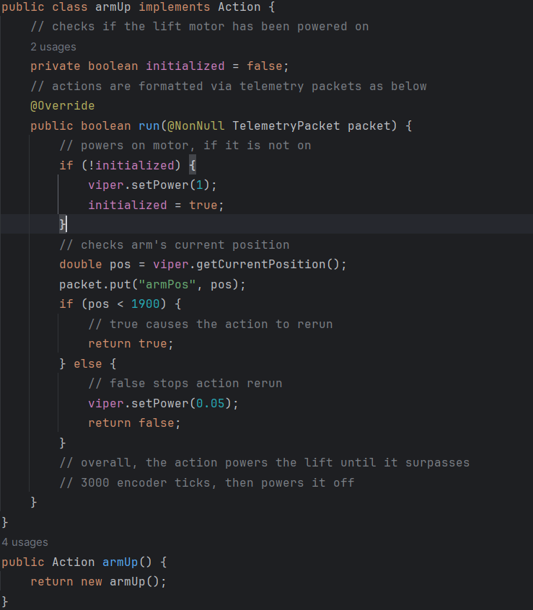
Roadrunner 1.0 Actions
Actions are methods used to operate electronic devices on the robot besides the wheel motors.
These can be the arm motors, wrist/claw servos, and sensors.
The code on the left sets the power of our viper slides to 1 while their position is below 1900 in encoder ticks. Once it reaches that amount, it sets the power to 0.05 and stops them in place. This action can be called with
arm_motor.armUp(); in the sequential action or
stopAndAdd(arm_motor.armUp()) in the trajectory.

Slide 10
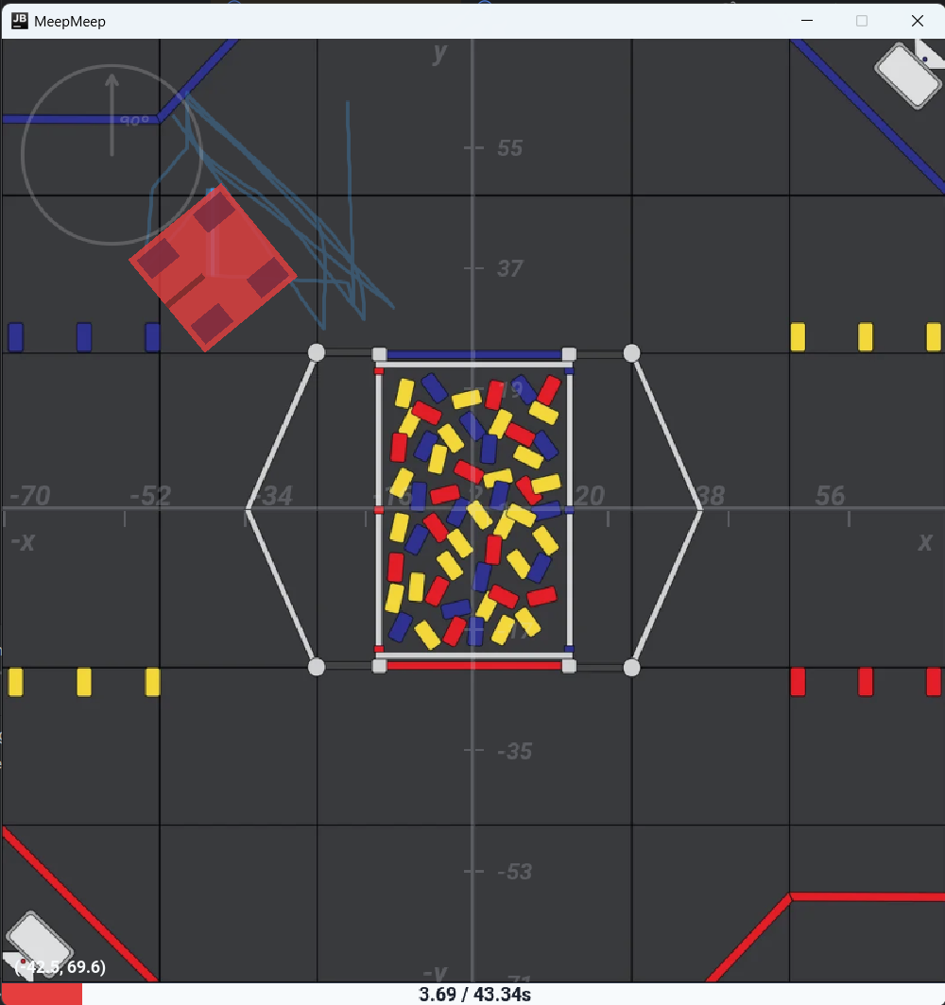
Meep Meep
Meep Meep is an optional tool used for efficient pathway development where you are able to quickly program trajectories and see the output displayed in a square tab.
Once successfully installed and a suitable pathway is developed, the trajectory can be copied over to the autonomous Opmode which uses Roadrunner.

Slide 11
Meep Meep Installation
Guide through the installation process:
https://github.com/rh-robotics/MeepMeep/blob/master/INSTALL.md

Slide 12
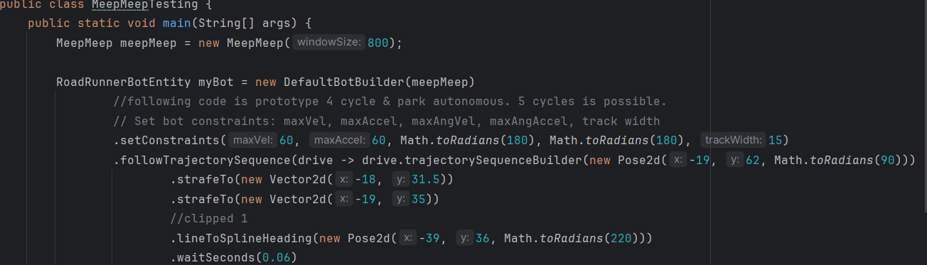
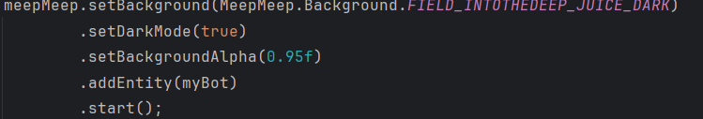
Meep Meep Programming
After a successful installation, a Meep Meep trajectory simulation can be built.
The basic commands follow the same principles as the roadrunner commands although with slight naming differences:
RR: .lineToSplineHeading(new Pose2d(-40, 36, Math.toRadians(220)))
MM: .strafeToSplineHeading(new Vector2d(-40, 36), Math.toRadians(220))

Slide 13
Meep Meep Programming
Useful methods:
.strafeTo(new Vector2d(-18, 31.5)) - stable heading towards a new point
.waitSeconds(0.06) - waiting x amount of seconds
.lineToSplineHeading(new Pose2d(-48, 49, Math.toRadians(130))) - moving to new point with a
different heading
.setTangent(Math.toRadians(90)) - setting starting direction to 90
degrees
.splineToConstantHeading(new Vector2d(-43, 63), Math.toRadians(90)) - making a spline movement to a new
point

Slide 14
Meep Meep Programming
After developing your trajectory, switch to Meep Meep and press the run button at the top of Android Studio. A tab simulating your trajectory and the time it takes should be displayed.
Tangent angle circle (increases clockwise)
Field map
Robot
coordinates
Blue lines (entire trajectory)
Bright blue line (current movement)
Timer

